Slide 1
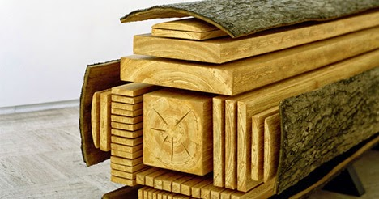
Calculating board footage & costing
Math 1435 Math Fundamentals
This Photo by Unknown Author is licensed under CC BY-SA-NC

Slide 2
Definitions
Board foot: Exclusively used in woodworking, the cubic volume of rough lumber. 1 board foot = 12”w x 12”L x 1”th or 144 cubic inches. You may see board foot expressed as bdft or BM (Board Measure).
Square foot: Surface area calculation, mainly used for veneers and sheet stock. Only accounts for Length and width. 1 sqft = 12” x 12”.
Waste factor: A percentage applied to board foot or square foot calculations to allow for things like defecting, optimizing of sheet stock and special veneer matches. You will notice with solid wood, the lower the grade of lumber, the higher the waste factor. Why?
Overrun: Extra material broken out to allow for setups, errors or materials handling. Complex parts require a larger overrun, simple parts require little or no overrun.

Slide 3
Definitions page 2
Bill of materials (BOM): A list of all of the parts required to build a unit. The BOM lists the rough sizes, finish sizes, special measurements (B.S.), species, waste factor and total bdft. Some BOM’s will also have material costs.
Veneer bill: Much like the BOM above, veneer bills list the parts required to veneer a panel. The parts such as face, back and crossbands are listed separately. Why?
Kerf allowance: The amount of material removed by the sawblade or cutter head.

Slide 4
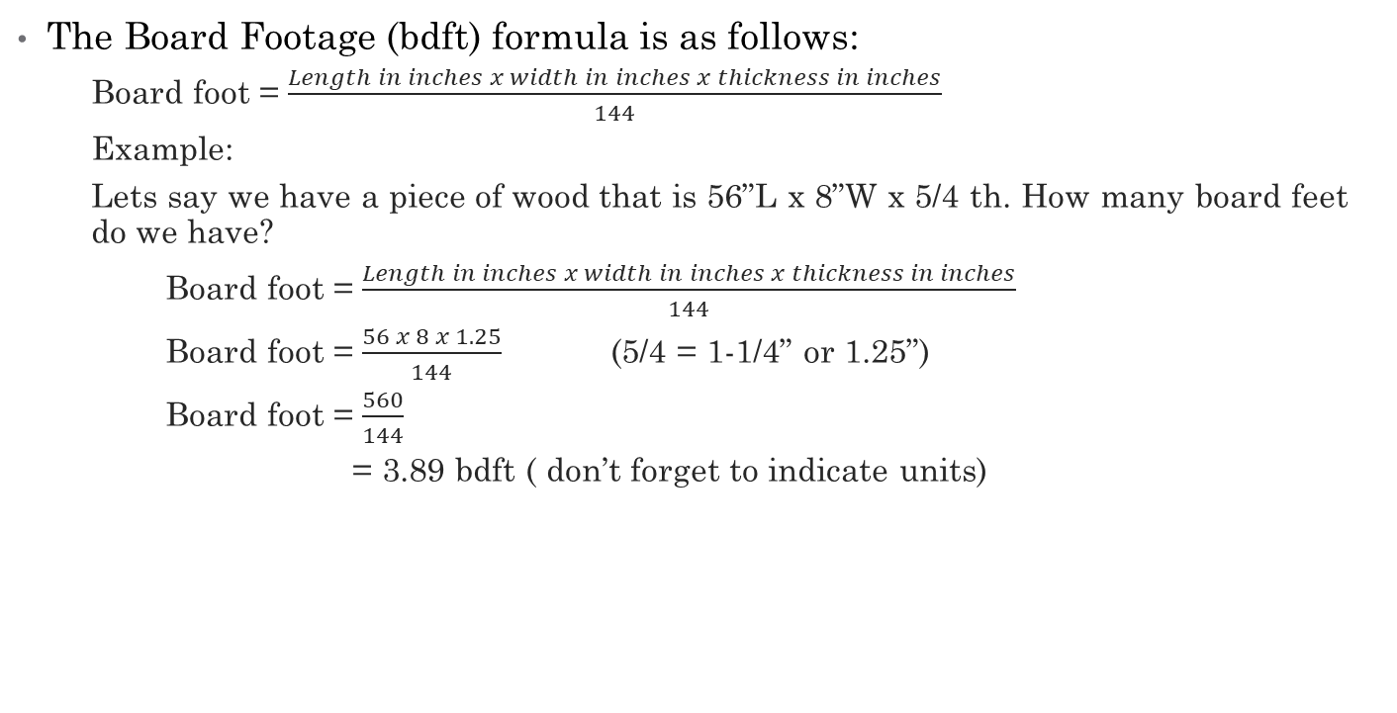
Calculating Board Footage
The Board Footage (bdft) formula is as follows:
Board foot = $\frac{Length in inches x width in inches x thickness in inches}{144}$
Example:
Lets say we have a piece of wood that is 56”L x 8”W x 5/4 th. How many board feet do we have?
Board foot = $\frac{Length in inches x width in inches x thickness in inches}{144}$
Board foot = $\frac{56 x 8 x 1.25}{144}$ (5/4 = 1-1/4” or 1.25”)
Board foot = $\frac{560}{144}$
= 3.89 bdft ( don’t forget to indicate units)

Slide 5
Calulating board footage practice
Calculate the following:
One board measuring 78” x 4” x 4/4.
Three boards each measuring 64” x 7” x 6/4.
Seven boards each measuring 88” x 3” x 8/4.
Two boards each measuring 102” x 3-1/2” x 12/4.

Slide 6
Calculating Board Footage Practice answers
Here are the answers:
2.167 bdft
14 bdft
25.67 bdft
14.875 bdft

Slide 7
Bill of Materials and Costing
It is important to know how to manipulate the Bill of Materials properly as costing is generally driven by the BOM. If you incorrectly calculate waste or board footage, your costing of the project will be incorrect and could cost your company a loss in profits or a loss of work.
Finish sizes are taken from the drawings.
Watch out for parts that have tennons. Finish size will be from the ends of the tennons. B.S. is the between shoulders measurement.
Also, watch the grain direction, Length is always the same direction as the grain, width is always across the grain.
Rough sizes are calculated from the finish sizes.
Rough sizes account for squaring of the ends, dressing the edges, planning to thickness, and saw kerfs for multiple parts in length and/or width.
Rough size = blank size when combining parts together in a blank.
Add 1” for rough length. Add ¼” for rough width. Add ¼” for every saw kerf if ganging parts. Add ½” to rough width for long parts or parts that require shaper work.

Slide 8
Bill of Materials and costing cont.
Part name and part quantity are just as important. Find a naming rule for your BOM so that similar parts of different units have the same name. i.e. Gables, front rail, back rail etc. If you have parts that are equal in size & machining keep them under 1 common name. i.e. gables – not right side gable & left side gable.
Parts per blank: The parts per blank tells us how many parts we can cut from the a blank.
Measure:
Per blank: the sqft or bdft total of a blank if you are ganging the parts.
Per unit: The total sqft or bdft of the part times the number of parts in the unit. We use the per unit calculation to price the unit.
Waste factor: The percentage to add to the per unit total measure value to include for defecting and rough mill operations. Make sure you are adding the percentage! The total should be higher than the “per unit” value.
Cost per unit: The “per unit” sqft or bdft value with the waste factor added multiplied by the cost per bdft or sqft for the material. Gives us the cost for the each part of the unit.

Slide 9
Bill of materials sample
See sample BOM attached to you printed package.

